Slide 1
COMP 3500 Introduction to Operating Systems Project 5 – Processes and System Calls Part 1: Overview
Dr. Xiao Qin
Auburn University http://www.eng.auburn.edu/~xqin
xqin@auburn.edu
Notes:
Fall’17: Project 4 is partitioned into projects 4 and 5. Overview is scheduled on 09b. Minutes:
Fall’16 Scheduled changed. 09a is now 08a. We are one lecture ahead of the schedule. Plan to add Lecture17-device management (see also 17-Device Management-Not Covered.pptx)
Fall’15: Cont. Lec08c-Deadlock Detection Slides 15-19
40 Minuets:

Slide 2
Project 5
Processes and System Calls

Slide 3
Project Objectives
To collaborate with your group members using git/GitLab
To start building a multi-tasking operating system
To develop system calls to manage processes
To develop system calls to manage file system states
Use GDB to debug OS/161
2 Weeks to achieve the above objectives!
Notes:
6 Weeks -> 3 Weeks (part 1).

Slide 4
What are available on Canvas?
Project description
FAQs
Instructions on adding system calls
Sample source code
getpid_syscall.c,
getpidtest.c,
sample_file.h,
sample_runprogram.c, and
sample_thread.h.

Slide 5
Three Tasks: Due on Nov. 3
Task 1: Code Reading
Individual
Task 2: Design
Discussion
Task 3: Programming
Individual

Slide 6
Three Sub-tasks of Tasks 3:
Task 3.1:
getpid
fork (required), execv, waitpid, _exit
Task 3.2:
open(const char *path, int oflag, mode_t mode)
read(int fd, void *buf, size_t nbytes)
write(int fd, const void *buf, size_t nbytes)
Task 3.3:
lseek(int fd, off_t offset, int whence)
close(int fd)
dup2(int oldfd, int newfd)
Project 5
Project 6

Slide 7
Three Tasks: Due on Nov. 11
Task 1: Code Reading
Individual; Soft Deadline: Oct. 31 (5 Days)
Task 2: Design
Collaboration; Soft Deadline: Nov. 2 (7 Days)
Task 3: Programming
Individual; Hard Deadline: Nov. 11 (14 Days)
Notes:
Due on March 24
Task 1: Code Reading
Individual; Soft Deadline: March 10 (3 Days)
Task 2: Design
Collaboration; Soft Deadline: March 15 (5 Days)
Task 3: Programming
Discussion; Hard Deadline: March 24 (9 Days)
Due on Nov. 11
Task 1: Code Reading
Individual; Soft Deadline: Oct. 8 (6 Days)
Task 2: Design
Collaboration; Soft Deadline: Oct. 18 (10 Days)
Task 3: Programming
Discussion; Hard Deadline: Nov. 11 (24 Days)

Slide 8
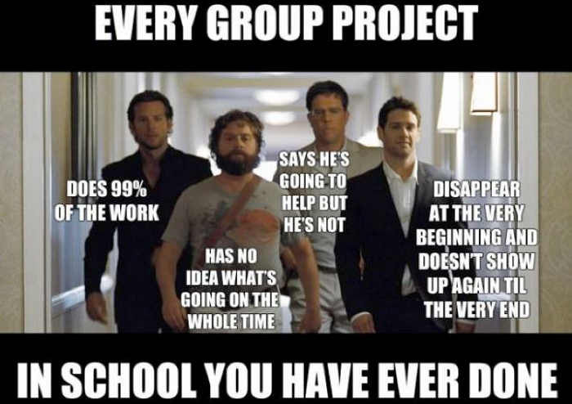
Notes:
Not all groups are perfect.
You can meet some who do not care about their grades, or simply do not know what to do.

Slide 9
Before add a file to git …
chmod 640 or chmod 644
A word about permissions:
0 = no operations allowed
1 = execute permission or the ability to cd in the case of a directory
2 = write permission
4 = read permission
Default value 711
Owner, Group Members, non-group members
Notes:
Your home directory will have permissions 711 by default. These permissions mean the following: 7 = 4+2+1:You (the owner) can read/write/execute 1 = 1:Other users in your group can cd/execute but not read or write 1 = 1:Other users not in your group can cd/execute but not read or write

Slide 10
To Build a Real Multi-tasking Operating System
In project 4, Cats-Mice program:
Functions linked into the kernel
Run inside the kernel
Reason? unable to run user-space code
Goal: Make OS/161 run user-space programs
Notes:
Your home directory will have permissions 711 by default. These permissions mean the following: 7 = 4+2+1:You (the owner) can read/write/execute 1 = 1:Other users in your group can cd/execute but not read or write 1 = 1:Other users not in your group can cd/execute but not read or write

Slide 11
Current Version
Reboot is the only working system call available to user-space code
The kernel does NOT understand what a process is
The kernel does NOT maintain any per-process state
Ninimal support for running executables
Objectives: Solve the above problems
Notes:
Your home directory will have permissions 711 by default. These permissions mean the following: 7 = 4+2+1:You (the owner) can read/write/execute 1 = 1:Other users in your group can cd/execute but not read or write 1 = 1:Other users not in your group can cd/execute but not read or write

Slide 12
System Calls
To implement an interface between user programs and the kernel
System Calls
Notes:
you have to implement the interface between user-mode programs ("userland") and the kernel. You will be provided part of the code needed for this assignment, and you are required to design and implement the missing pieces. Your job also includes implementation of the subsystem that keeps track of the multiple tasks you will have in the future. Importantly, you need to design data structures for "process" (Hint: look at kernel include files of your favorite operating system for suggestions,

Slide 13
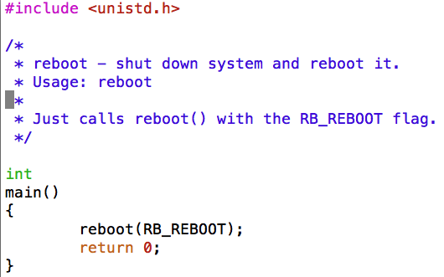
How does a user program work?
Existing User Programs
~/cs161/src/sbin
Reboot, halt, poweroff
Notes:
you have to implement the interface between user-mode programs ("userland") and the kernel. You will be provided part of the code needed for this assignment, and you are required to design and implement the missing pieces. Your job also includes implementation of the subsystem that keeps track of the multiple tasks you will have in the future. Importantly, you need to design data structures for "process" (Hint: look at kernel include files of your favorite operating system for suggestions,

Slide 14
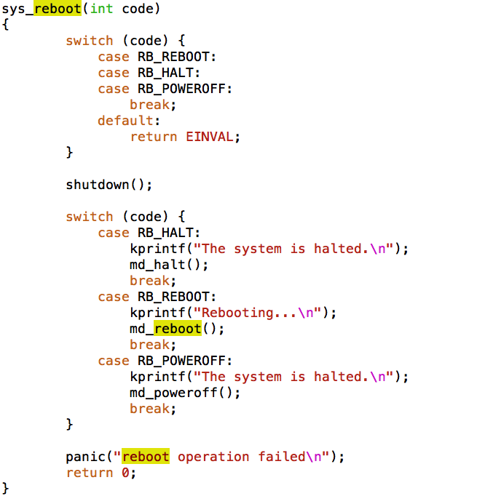
More about reboot
~/cs161/src/kern/main/main.c

Slide 15
How to run a user program?
Run normal programs compiled from C on the System/161 simulator
cs161-gcc
Notes:
you have to implement the interface between user-mode programs ("userland") and the kernel. You will be provided part of the code needed for this assignment, and you are required to design and implement the missing pieces. Your job also includes implementation of the subsystem that keeps track of the multiple tasks you will have in the future. Importantly, you need to design data structures for "process" (Hint: look at kernel include files of your favorite operating system for suggestions,

Slide 16
Task 1: Read Source Code
You must submit your answers to these questions

Slide 17
Task 1: Read Source Code
kern/userprog: the user program
loadelf.c, runprogram.c, anduio.c
kern/arch/mips/mips: traps and syscalls
syscall.c: handles traps that happen to be syscalls
~/cs161/src/lib/crt0: user program startup
It invokes the user program's main()
Notes:
MPIS control executions

Slide 18
Task 2: Design Your Project
Who will be responsible for which parts of your implementation?
(Document your discussion in the collaboration report)
Data structures
Global and local variables
Algorithms for the system calls

Slide 19
Task 2: Sample Design Questions
What data structures will you need to manage multiple processes?
What relationships do your new data structures have with the OS/161?
How will you manage file accesses?
When the shell invokes the cat command, and cat starts to read file1, what will happen if another program also tries to read file1?
What would you like to happen?

Slide 20
Task 3: Implementing System Calls
getpid
I will show you how to implement this system call)
fork (required), execv, waitpid, _exit
Project 5

